Slide 1

Time and Date
The original Date
Calendar
Joda
Java 8

Slide 2

See Also
http://stackoverflow.com/questions/1969442/whats-wrong-with-java-date-time-api

Slide 3
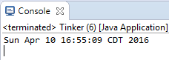
A Brief History of Time (and Date)
JDK 1.0 1996 java.util.Date
Now
Milliseconds since January 1, 1970 Midnight GMT
import java.util.Date;
Date d = new Date();
System.out.println(d);
Date d = new Date();
Date d = new Date(1000L);
Date d = new Date( 100, 0, 12);
1900 + n
0 (January) – 11 (December)
Misleading: no timezone info
Streams of bytes … two ways (into your program and out of your program)
Disks, consoles, sockets, keyboards, printers
Know how to talk streams and you can talk to anything
Initialization (constructor) is different. Use is the same.

Slide 4


Date Formatting
JDK 1.0 1996 java.util.Date
"America/Los_Angeles"
Date d = new Date();
TimeZone zone = TimeZone.getTimeZone("America/Pacific");
DateFormat dfm = new SimpleDateFormat("YYYY MMM dd @ HH:mm z");
dfm.setTimeZone(zone);
String s = dfm.format(d);
System.out.println(s);
Streams of bytes … two ways (into your program and out of your program)
Disks, consoles, sockets, keyboards, printers
Know how to talk streams and you can talk to anything
Initialization (constructor) is different. Use is the same.

Slide 5
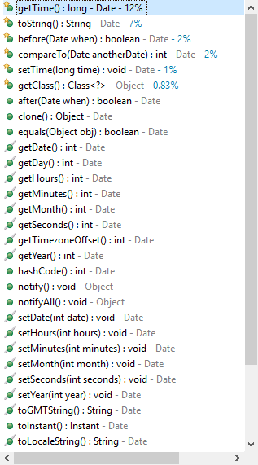

Date
Streams of bytes … two ways (into your program and out of your program)
Disks, consoles, sockets, keyboards, printers
Know how to talk streams and you can talk to anything
Initialization (constructor) is different. Use is the same.

Slide 6

A Brief History of Time (and Date)
JDK 1.0 1996 java.util.Date
Tries to be “timestamp” and “calendar”
Does not carry timezone info
1900+
Months start at 0
Objects are mutable (lots of setters)
Date is actually Date+Time
Streams of bytes … two ways (into your program and out of your program)
Disks, consoles, sockets, keyboards, printers
Know how to talk streams and you can talk to anything
Initialization (constructor) is different. Use is the same.

Slide 7
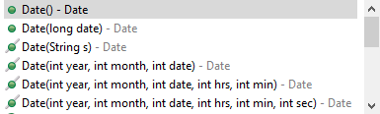
Separating the Calendar
JDK 1.1 1997 java.util.Calendar
Date is just a timestamp
“Calendar” handles the calendar needs
Streams of bytes … two ways (into your program and out of your program)
Disks, consoles, sockets, keyboards, printers
Know how to talk streams and you can talk to anything
Initialization (constructor) is different. Use is the same.

Slide 8
Using the Calendar
JDK 1.1 1997 java.util.Calendar
Date d = new Date();
TimeZone zone = TimeZone.getTimeZone("America/Los_Angeles");
Calendar cal = new GregorianCalendar();
cal.setTime(d);
cal.setTimeZone(zone);
System.out.println(cal.get(Calendar.HOUR));
cal.set(Calendar.MONTH, Calendar.JANUARY);
Date nd = cal.getTime();
DateFormat dfm = new SimpleDateFormat("YYYY MMM dd @ HH:mm z");
dfm.setTimeZone(zone);
String s = dfm.format(nd);
System.out.println(s);
Number 0 (not an enum)
Streams of bytes … two ways (into your program and out of your program)
Disks, consoles, sockets, keyboards, printers
Know how to talk streams and you can talk to anything
Initialization (constructor) is different. Use is the same.

Slide 9
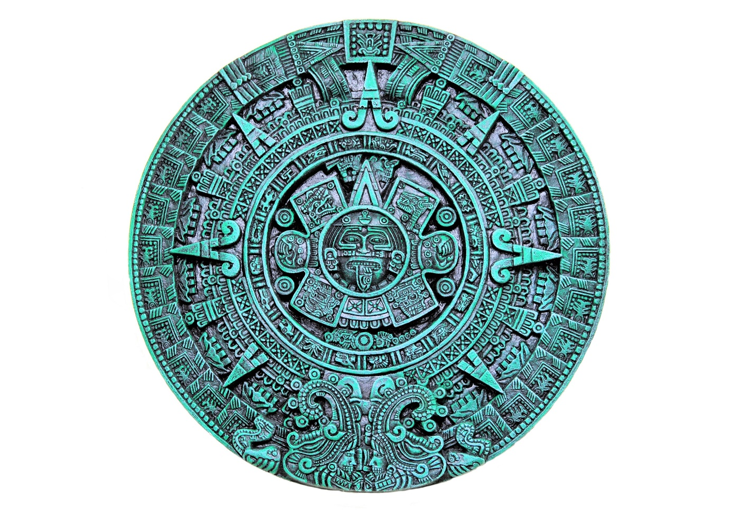
A Brief History of Time (and Date)
JDK 1.1 1997 java.util.Calendar
Fixed the 1900+
Still January = 0
Still mutable
Still Date + Time
Streams of bytes … two ways (into your program and out of your program)
Disks, consoles, sockets, keyboards, printers
Know how to talk streams and you can talk to anything
Initialization (constructor) is different. Use is the same.

Slide 10

Joda and Java 8
Joda Time
http://www.joda.org/joda-time/
JSR-310
Java 8: “java.time”
Streams of bytes … two ways (into your program and out of your program)
Disks, consoles, sockets, keyboards, printers
Know how to talk streams and you can talk to anything
Initialization (constructor) is different. Use is the same.

Slide 11
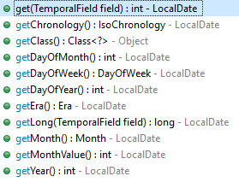
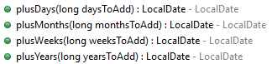
Java 8 LocalDate
LocalDate dateOnly = LocalDate.now();
System.out.println(dateOnly);
dateOnly = LocalDate.of(2015, Month.OCTOBER, 18);
System.out.println(dateOnly);
dateOnly = LocalDate.of(2015, 1, 18);
System.out.println(dateOnly);
dateOnly = LocalDate.parse("2013-02-03");
System.out.println(dateOnly);
dateOnly = LocalDate.parse("3/4~2015",
DateTimeFormatter.ofPattern("M/d~yyyy"));
System.out.println(dateOnly);
Streams of bytes … two ways (into your program and out of your program)
Disks, consoles, sockets, keyboards, printers
Know how to talk streams and you can talk to anything
Initialization (constructor) is different. Use is the same.

Slide 12
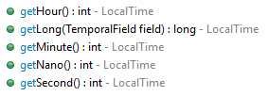
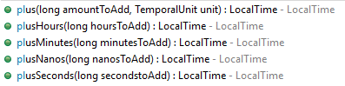
Java 8 LocalTime
LocalTime timeOnly = LocalTime.now();
System.out.println(timeOnly);
timeOnly = LocalTime.of(14, 15, 45);
timeOnly = LocalTime.MIDNIGHT;
timeOnly = LocalTime.parse("01:22");
Streams of bytes … two ways (into your program and out of your program)
Disks, consoles, sockets, keyboards, printers
Know how to talk streams and you can talk to anything
Initialization (constructor) is different. Use is the same.

Slide 13
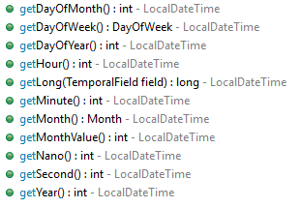
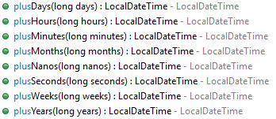
Java 8 LocalDateTime
LocalDateTime dt = LocalDateTime.now();
System.out.println(dt);
Streams of bytes … two ways (into your program and out of your program)
Disks, consoles, sockets, keyboards, printers
Know how to talk streams and you can talk to anything
Initialization (constructor) is different. Use is the same.

Slide 14
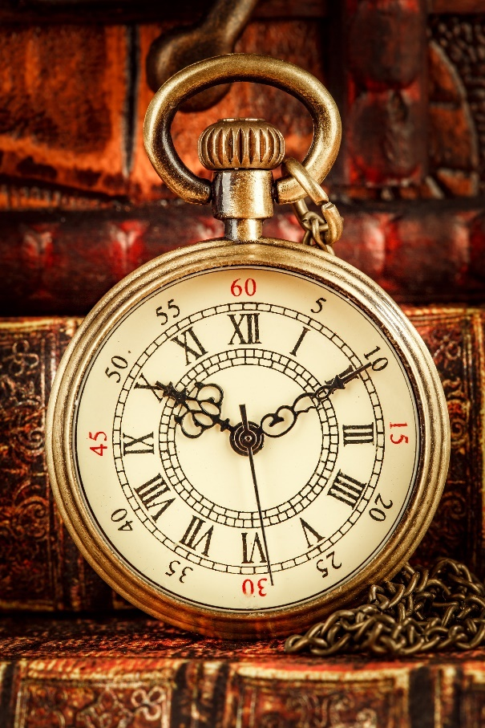
Java 8 ZonedDateTime
ZoneId id = ZoneId.of("Europe/Paris");
System.out.println(id);
ZonedDateTime zoned = ZonedDateTime.now();
LocalDateTime dt = LocalDateTime.now();
zoned = ZonedDateTime.of(dt, id);
Streams of bytes … two ways (into your program and out of your program)
Disks, consoles, sockets, keyboards, printers
Know how to talk streams and you can talk to anything
Initialization (constructor) is different. Use is the same.

Slide 15
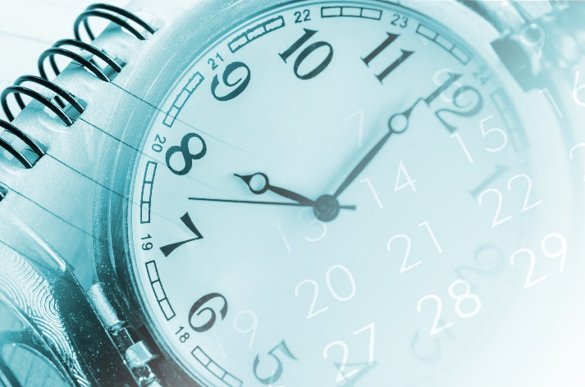
Java 8 Periods and Durations
LocalDate date = LocalDate.now();
Period per = Period.ofDays(14);
date = date.plus(per);
date = date.plus(per);
LocalDateTime dt = LocalDateTime.now();
Duration dur = Duration.ofMinutes(120);
dt = dt.minus(dur);
Streams of bytes … two ways (into your program and out of your program)
Disks, consoles, sockets, keyboards, printers
Know how to talk streams and you can talk to anything
Initialization (constructor) is different. Use is the same.

Slide 16

Tinkering
Use the java.time classes to print the current date/time in New York, Honolulu, and Bejing.
Write a program to print the number of seconds left in the year (read up on the java.time API).
Notes:
Reference the discussion area

